Slide 1
Where are we now?: Constructing an approach to assessing without levels
Andrew Frapwell

Slide 2
Session aims:
Review and challenge thinking and practice
Construct an evidence-based approach to assessing without levels

Slide 3
Reflection on 4+ years of Assessing without Levels
What is assessing without levels?
Have we changed our planning, the way we teach or assess in PE?
How do we effectively use summative assessment and is it aligned to NCPE 2013 standards?
How is our formative assessment used to meet learners’ needs?
Do commercial tracking systems drive our assessment approach?
Is our assessment system ‘fit for purpose’?

Slide 4
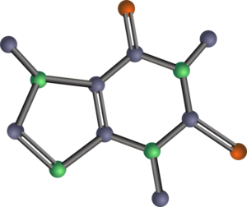
What is the NC model?
“A revised model that focuses on inclusion, mastery and progress.” p.50
DfE (2011). The Framework for the National Curriculum. A report by the Expert Panel. London: Department for Education.

Slide 5
DfE (2011) - Assessment
“We do not want to encourage the promulgation of huge numbers of atomistic and trivial statements of attainment that characterised earlier versions of the National Curriculum”

Slide 6
What is statutory for state maintained schools? SI 1437
Programme of study for physical education
Keep a curriculum record
Report ‘brief particulars of achievements’ in PE each year
Report ‘comments on general progress’
Share arrangements to parents to discuss the report with the pupil’s teacher
At the end of the key stage report against the attainment target for PE

Slide 7
Non-statutory?
Termly or more frequent reporting of summative assessment
Assessment for Learning
Formative assessment

Slide 8
Task: What is..
…assessment?
…evidence?
…recording?
…tracking?
…monitoring?
…reporting?
…a system of assessment
Notes:
Tutor Notes:
What we are attempting to do here (and with the previous learner activity re layers and principles) is to establish a baseline and common ground / common understanding of our assessment system and assessment language.
Assessment: The response here will typically be about teacher judgement against standards. Assessment is more than this. Assessment is an ongoing communicative process that arises from the teaching learning transaction. Such communication (should) promotes a teaching-learning dialogue that elicits information which can be used by both teachers and learners to inform decision-making about how to improve. This is the primary purpose of assessment.
Evidence. In education terms ‘evidence’ refers to documentary proof about progress and standards. The evidence may have been generated by the use of ICT in a lesson to improve learning (e.g. a digital video of a gymnastics sequence used to visually feedback to learners or a video of pupils feeding back to each other about their performance so that they can improve what and how they feedback) as opposed to prove learning. In other words evidence to ‘prove’ learning and progress has happened. may be generated from evidence that was used in lessons to ‘improve’.
Recording. We might not keep a record of every piece of evidence we generate, but the evidence we do keep is a record. This could be in the form of digital stills, digital videos or pupil feedback sheets etc. We might also annotate information in a class list next to a learner’s name or we might record a number or a grade next to their name (this is not a proposal). These annotated records are ‘records’ but they are not ‘evidence’ or proof. What is important in the discussion task, is that iPads for example, might be used for pupils to ‘compare and improve performances with previous ones’. They haven’t been used to video a performance to prove to senior leadership that assessment is being carried out or prove to Ofsted the standard that has been attained. The iPads have been used to IMPROVE. The benefit, however is that the digital video captured can also be used to PROVE.
Tracking. The evidence and other records we keep overtime form our ‘track record’. Contrary to popular belief, our track record does not need to be in the form of data spreadsheets, it does not need to be for all pupils and it does not need to be for every activity. What it should be is a representative sample of our learners, gender, FSM, SEN and more able etc. Please see Ofsted video which states that Ofsted “do not need to see vast amounts of data, spreadsheets, charts or graphs, nor are they looking for any specific, frequency type or volume of marking or feedback.” https://www.youtube.com/watch?v=H7whb8dOk5Q
Monitoring. We can use our track record to monitor the progress of different groups of children. This is a catch all, as early recognition and early intervention should happen as a result of information elicited from our ongoing ‘day to day’ communication with learners.
Reporting. This should not be viewed as simply reporting to parents about pupil progress towards standards. We can report to other staff, we can report information to senior leadership. Some schools now include a report about a pupil’s attitude, however careful consideration should be taken about how this information is arrived at and used (see attitudes, Unit 1).
A ‘system of assessment’ is therefore the school’s approach which includes each of the previous points.
NB. It is important to understand that everything on the slide listed after assessment requires ‘administration’ – they are things that happen after ‘assessment’ has taken place.

Slide 9
Assessment fit for purpose
How do we report or ‘show’ progress?
Numbers?
Letters?
Rainbow colours?
Hierarchical ‘I can’ statements?
Tick boxes against statements?

Slide 10
Understanding Mastery
All/most pupils can and will achieve
Development of deep structural knowledge
Understanding of principles / concepts
Carefully chosen activities supporting the opportunity to make connections
Keeping the class working together
Longer time on key learning
The National Curriculum 2014 is seeking to develop deep sustainable learning in line with successful countries
Notes:
Tutor Notes:
Mastery is the expected standard written into the national curriculum programme of study.
It is therefore an inclusive standard that all pupils are expected to achieve.
Many primary schools have misinterpreted ‘mastery’ as some kind of exceptional attainment that is achievable only by the very few. This will need addressing in your discussions with candidates.
Everything we know about research into childhood growth and development suggests that unless children are special educational needs or disabled, they WILL be able to achieve the expected standard. It is our job to develop an approach that enables this.
Nationally, teachers have received their ‘mastery’ training for English and Maths teaching. Part of this training requires teachers to spend longer on key learning to ensure learners grasp essential knowledge and concepts and key skills etc. If teachers have understood this concept then why do they still approach the teaching of PE as one skill per week and in half-term blocks? In a hockey context for example, pupils might be on week 4 = shooting, when they haven’t even mastered passing introduced in week 1!
Consideration of mastery plants the seeds for learning in later units of this course. If we do not know what mastery looks like, how do we begin to plan for it (Unit 3)?, how do we teach for it (Units 2 an 5)?, and how do we assess it (Unit 4)?

Slide 11
Mastery – nothing new
Started with Bloom’s taxonomy
Developed by Biggs and Collis – SOLO taxonomy
Structure of Observed Learning Outcomes
SOLO taxonomy provides a simple way of describing how learning outcomes grow in complexity from surface to deep understanding

Slide 13
The language of learning
SOLO stage | Verbs used in learning outcomes
Extended abstract Working at greater depth | Generalise, predict, evaluate, reflect, hypothesise, theorise, create, prove, justify, argue, compose, prioritise, design, construct, perform
Relational Expected - Mastery | Sequence, classify, compare & contrast, explain, (cause & effect), analyse, form an analogy, organise, distinguish, question, relate, apply
Multistructural Developing | Describe, list outline, complete, continue, combine
Unistructural Basic | Define, identify, name, draw, find, label, match, follow a simple procedure

Slide 14
Physical Education purpose and aims
Purpose of Study
Aims
A high-quality physical education curriculum inspires all pupils to succeed and excel in competitive sport and other physically-demanding activities.
It should provide opportunities for pupils to become physically confident in a way which supports their health and fitness.
Opportunities to compete in sport and other activities build character and help to embed values such as fairness and respect.
The national curriculum for physical education aims to ensure that all pupils:
develop competence to excel in a broad range of physical activities
are physically active for sustained periods of time
engage in competitive sports and activities
lead healthy, active lives
Notes:
Tutor Notes:
The physical education purpose of study and aims have been replicated from the DfE (2013) programme of study for PE.
This is the first time since the Education Reform Act (ERA) 1988, which legislated the introduction of a National Curriculum, that a purpose and aims have been documented for subjects.
The purpose of study consists of 3 sentences.
There are 4 physical education aims.
The Coachwise publication commissioned by afPE deals comprehensively with the language used in the purpose of study and aims: Frapwell, A. (2015). A Practical Guide to Assessing Without Levels. Leeds: Coachwise, pp34-42.
Direct candidates to relevant and appropriate legislation – for example the Chief Medical Officer’s physical activity levels guidelines, the obesity strategy listed in the tutor notes on slide 5 and the Ofsted (2013) physical education summary report ‘Beyond 2012’ also listed in the tutor notes on slide 5.

Slide 15
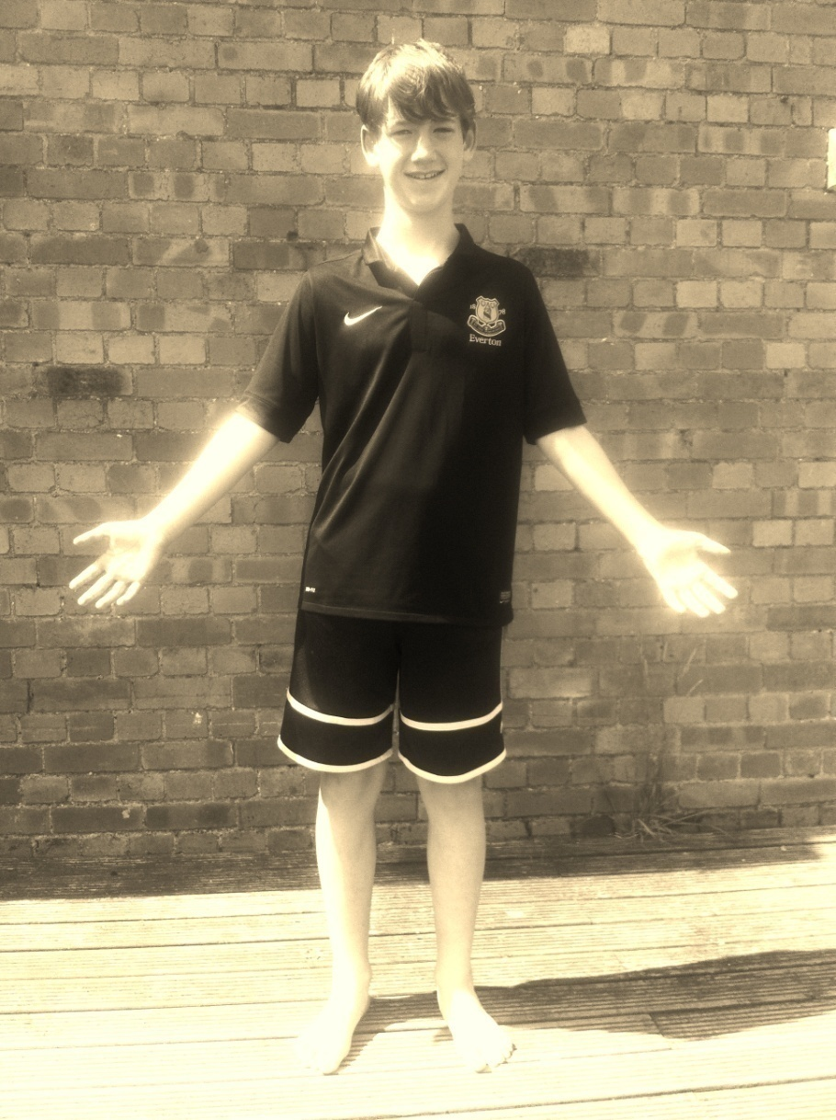
What is the standard of learning expected?: Head – Heart – Hands
Cognitive Domain
Physical Education
The thinking physical being:
✓Decision maker
✓Analytical – deep understanding
✓Confident
✓Tactician
The Psychomotor Domain
Physical Activity and Sports
The doing physical being:
✓Physically competent
✓Growth and development
✓Physically Active
✓Competitive
The Affective Domain
Physical Activity and Health
The feeling physical being:
✓Social and Emotional
✓Involvement and engagement
✓Attitude
✓Character, values
✓Healthy active lifestyle
The doing physical being:
✓Physically competent
✓Growth and development
✓Physically Active
✓Competitive
©2012 afTLC LTD
Notes:
Tutor Notes:
The afPE Assessing Without Levels book (Frapwell 2015) explored framing the standards in three broad categories or domains that learning and development are generally divided into (Bloom 1956):
Physical development (Psychomotor domain)
Cognitive development (Cognitive domain)
Social/emotional development (affective domain)
The slide diagram illustrates a 10 year old boy at the end of key stage 2 with labels drawing attention to key features of his development.
This holistic way of looking highlights that learning in PE is not just in the physical domain.*
What we get children to do in PE (Psychomotor), and what we get children to think about (Cognitive), should have a positive ‘affect’ (Affective domain), which leads to a positive ‘effect’ – children feel good about themselves, enjoy their PE programme and go on to choose to follow more physical activity and/or sport as part of a healthy active lifestyle when/if the opportunity is offered at school or in community clubs.
* Please note that framing the way we view learning in PE as three domains is ‘a way’ not ‘the way’. What is important, however it is framed, is that the standards are understood, planned for, taught and assessed. This is a statutory requirement for all state schools (see next four slides).

Slide 16
KS1 Doing - Hands | KS1 Thinking - Head | KS1 Feeling - Heart
Develop fundamental movement skills (specifically master basic movements including running, jumping, throwing and catching) Develop competence Develop agility, balance and coordination Perform dances using simple movement patterns | Apply skills Develop simple tactics for attacking and defending Develop competence Develop confidence | Work individually and with others Develop competence Develop confidence
Contexts: Team games; dance; a range of physical activities (individual and cooperative); competitive situations (against self and others); possibly swimming; increasingly challenging
Notes:
Tutor Notes:
The key language, or learning constructs (as referred to by Tim Oates, chair of the Expert Panel who reviewed the curriculum) have been synthesised from the Physical Education Programme of Study and bullet listed in the three domains introduced in the previous slide.
The list of possible activities has not been added as these are non-statutory. The contexts that are listed at the bottom of the table are a statutory requirement as they are referred to in the PE PoS and not listed in brackets.
Collectively, the bulleted learning constructs in each of the three columns form the standard expected by the end of Key Stage 1. In other words, schools will design a curriculum that caters for all learners to achieve the learning standard over the course of two years (Y1 and Y2). There is no right or wrong way to achieve this (although there may be better ways), which allows teachers opportunity for a flexible approach to planning how to scaffold or construct teaching and learning.
Although three separate columns are represented, they should be seen as three interwoven categories reflecting the integrative nature of learning.
In relation to the language used, the afPE book (Assessing Without Levels) examines this in more detail (pp57-62).

Slide 17
KS2 Doing - Hands | KS2 Thinking- Head | KS2 Feeling - Heart
Develop a broader range of skills (specifically running, jumping, throwing and catching in isolation and in combination) Perform dances using a range of movement patterns Develop flexibility, strength, technique, control and balance | Apply a broader range of skills (specifically running, jumping, throwing and catching in isolation and in combination) Link skills to make actions and sequences of movement Learn how to evaluate and recognise their own success Compare and improve performances with previous ones Apply basic principles suitable for attacking and defending | Enjoy communicating, collaborating and competing with each other Develop flexibility, strength, technique, control and balance
Contexts: Competitive games; dance; outdoor and adventurous activity challenges; different physical activities and sports; individual and team; swimming (if not scheduled in KS1).
Notes:
Tutor Notes:
The learner activities suggested on the previous slide can also be repeated for this slide.
Breadth refers to the range of contexts or the extensiveness of the study we provide. “Competitive games” for example indicates that to meet the minimum entitlement we should provide at least two competitive games contexts during the key stage (over a four year period). If we ensure one of these is an individual and one a team game then we also meet these stipulated statutory contexts. Outdoor and adventurous activity challenges is also plural, so several challenges ranging from low level problem solving activities to orienteering and mountain biking for example can be offered (where appropriate to expertise and facilities).
Depth refers to the profundity of learning engagement in the breadth of study or range of learning contexts offered. For example collaboration (cooperation, teamwork, positive attitudes, leadership, followship, commitment etc.), are all important for effective collaboration and opportunity to deepen learning and ensure these skills and values are mastered* should be provided.
Care needs to be taken that breadth is not mistaken for the number of activities offered in each of the contexts so as not to lead to learning that is ‘a mile wide and an inch deep’, and that the duration** of units afford sufficient time to master learning.
It is useful at this stage to develop candidate awareness of the type and nature of the bulleted learning constructs, layering information for assessment to impact on learning and progress in physical education). The constructs are mainly learning focused, with reference also made to performance. This approach aligns to what we have learned about the Psychology of learning, which highlights that we are motivated by improving learning as well as being motivated by performance. This work has been developed by many researchers over the past 30-40 years, including Carol Dweck re her ‘Growth mindset’ label. Take the fourth bulleted point in the centre column that states: “Compare and improve performances with previous ones.” What is important here is that all pupils know how to improve their performances with previous ones, not the actual standard of performance. This approach supports a growth mindset, in that pupils focus on the learning processes required to improve performance, rather than simply a focus on the performance itself. When practice continuously only focuses on the performance which is then judged and graded (or levelled) by a teacher, and this grade doesn’t improve, it can lead to “learned helplessness” or a fixed mindset.
For background reading please see Seligman’s work: https://www.britannica.com/topic/learned-helplessness and Dweck’s work: http://www4.esu.edu/academics/enrichment_learning/documents/pdf/developing_growth_mindset.pdf
* Mastery will be examined in the forthcoming slides

Slide 18
Accuracy & impact of assessment
teachers use any assessment for establishing pupils’ starting points, teacher assessment and testing to modify teaching so that pupils achieve their potential by the end of a year or key stage; inspectors should note that Ofsted does not expect to see any particular system of assessment in place.
assessment draws on a range of evidence of what pupils know, understand and can do across the curriculum
teachers make consistent judgements about pupils’ progress and attainment, for example within a subject, across a year group and between year groups.

Slide 19
Thank you
Andrew Frapwell
andrew@afTLC.com
07803 603450
Simon Roche
cpd@afPE.org.uk
01905 855584

